Slide 1
Module 1.1 / Week 1
Assurance and Audit Overview

Slide 2
Learning Objectives
1.1 Understand the framework for assurance engagements and the types of assurance engagements that can be provided.
1.2 Define auditing and appreciate the fundamental principles underlying an audit.
1.3 Appreciate the attributes of accounting information and understand the reasons giving rise to demand for assurance.
1.4 Explain the concept of the expectation gap, especially in the areas of auditor’s report messages, corporate failures, fraud and communicating different levels of assurance, and appreciate the relationships between the auditor, the client and the public.
1.5 Appreciate the role of auditing standards and their authority under the Corporations Act 2001.
1.6 Obtain an overview of other applications of the assurance function, including compliance engagements, performance engagements, comprehensive auditing, internal auditing and forensic auditing, as well as providing assurance on subject matter other than historical financial information.

Slide 3
LO 1.1
The Framework for assurance engagements and the types of assurance engagements

Slide 4
The Framework of Assurance Engagement
Many parties provide reports to users as an aid to making decisions.
Reports are potentially biased due to the vested interests of the report providers.
Users may demand that the credibility of the report be enhanced by having an independent expert examine it.
Financial reports are just one type of report that can be assured.

Slide 5

Definition of Assurance Engagement
‘An engagement in which a practitioner aims to obtain sufficient appropriate evidence in order to express a conclusion designed to enhance the degree of confidence of the intended users other than the responsible party about the outcome of the measurement or evaluation of an underlying subject matter against criteria.’

Slide 6
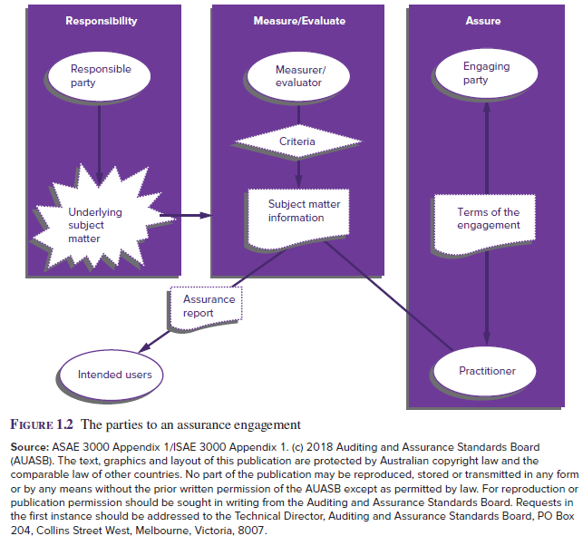
The Parties to an Assurance Engagement
Source: Grant, G. & Simnett, R. (2018). Auditing & Assurance Services In Australia (7th Ed), Sydney, Australia: McGraw Hill

Slide 7
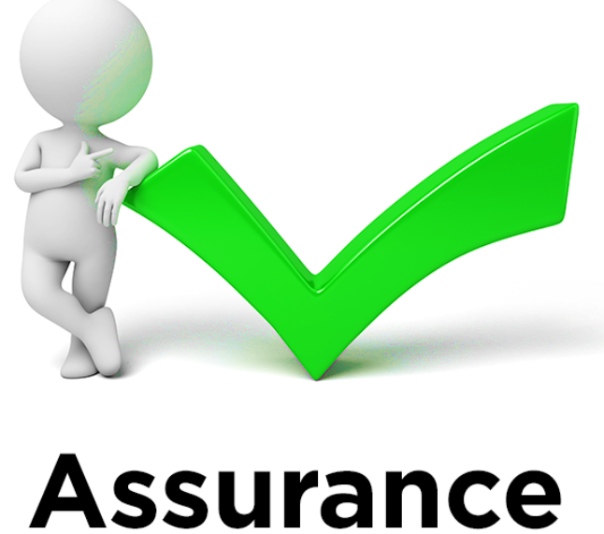
Fives Elements of Assurance Engagement
Three-party relationships:
        assurance practitioner (auditor)
        responsible party (preparer)
        intended user
      2. Underlying subject matter
      3. Criteria
      4. Sufficient appropriate evidence
      5. A written assurance report

Slide 8
Why there is value in the assurance service?
Independence
    Users derive value from the knowledge that the assurance provider has no interest in the information other than for its usefulness.
Expertise
    Assurers must have the competence to obtain sufficient relevant information to provide a reasonable basis for their conclusions.
    Requires professional judgment and professional scepticism.

Slide 9
Professional judgment and professional scepticism
Professional Judgment
    involves the application of relevant training, knowledge and experience in making informed decisions about appropriate courses of action.
Professional Scepticism
    an attitude that includes a questioning mind, being alert to conditions indicating possible misstatement and critically assessing audit evidence.

Slide 10
Types of Assurance Engagement
Reasonable assurance engagements are commonly called 'audit engagements'.
Limited assurance engagements are commonly called 'review engagements'.
There are also engagements that provide no assurance:
    Agreed-upon procedures engagements where the auditor reports their findings and doesn’t provide assurance.

Slide 11
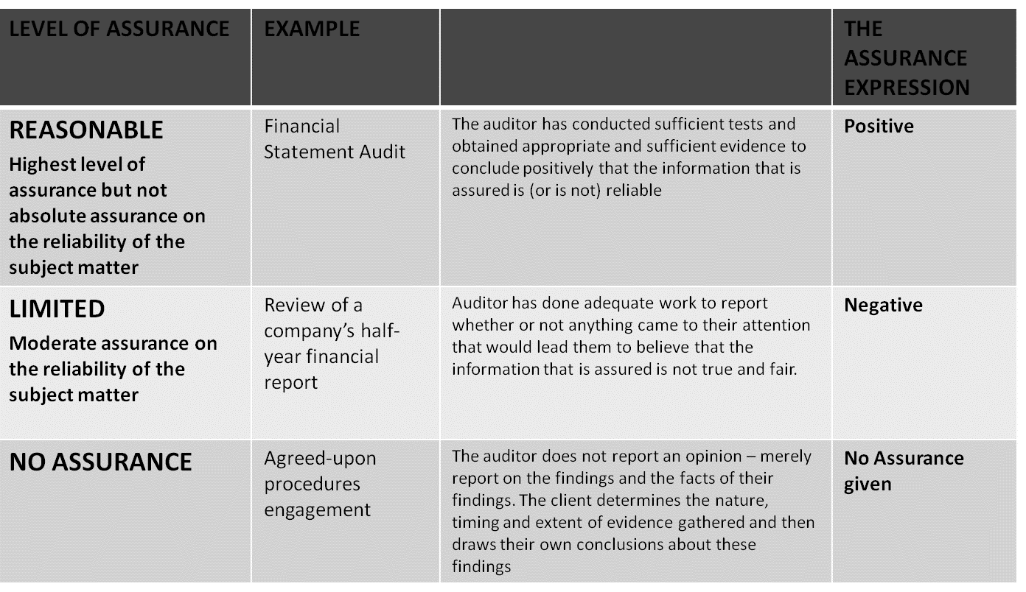
Different Levels of Assurance
Source: Moroney, R., Campbell, F., & Hamilton, J., (2017). Auditing: A Practical Approach (3rd ed.), Australia: Wiley

Slide 12
Attestation and Direct Engagement
Audit and review engagements can involve either an attestation or a direct engagement.
Attestation Engagement
  Requires a party other than the assurer to measure or evaluate the underlying subject matter against the criteria. The assurer then measures or evaluates the underlying subject matter against the criteria, and applies assurance skills and techniques to obtain sufficient appropriate evidence about the outcome of this measurement or evaluation.
Direct Engagement
  The auditor directly measures or evaluates the underlying subject matter against the criteria.

Slide 13
LO 1.2
Auditing: Definition and fundamental principles

Slide 14
Auditing Definition
A Statement of Basic Auditing Concepts (ASOBAC—the American Accounting Association) defines auditing as:
‘A systematic process of objectively obtaining and evaluating evidence regarding assertions about economic actions and events to ascertain the degree of correspondence between those assertions and established criteria, and communicating the results to interested users.’

Slide 15
The important parts of this definition
  Systematic process - audits are structured activities
  Objectivity- freedom from bias
  Obtaining and evaluating evidence - allows the auditor to determine the support for assertions or representations
  Assertions about economic actions and events - describes the subject matter of an audit
  Degree of correspondence … established criteria - the purpose of the audit is to determine conformity with some specified criteria
  Communicating results - the results must be communicated to interested parties

Slide 16
Fundamental Principles of Professional Ethics
Contained in national and international Codes of Ethics:
      integrity
      objectivity
      professional competence and due care
      confidentiality
      professional behaviour

Slide 17
Fundamental Auditing Principles
Knowledge
Responsibility
Quality control
Rigour and scepticism
Evidence
Professional judgment
Documentation
Communication
Association
Reporting

Slide 18
LO 1.3
Attributes of accounting information and demand for assurance

Slide 19
Attributes of Auditing Profession
From AASB/IASB framework, the following attributes of accounting information provide the basis for the audit function:
          Fundamental characteristics
                relevance
                faithful representation
          Enhancing characteristics
                comparability
                verifiability
                timeliness
                understandability

Slide 20
Demand of Assurance
Demand arises because users are not able to establish the credibility of the information they are presented with.
This may be due to:
  Conflict of interest—managers may present biased information, as they are also evaluated on the information.
  Consequence—information provided forms the basis of many users’ decisions.
  Complexity—many users do not have the expertise required to determine the quality of information presented.
  Remoteness—the separation of owners from management prevents users from assessing information quality.

Slide 21
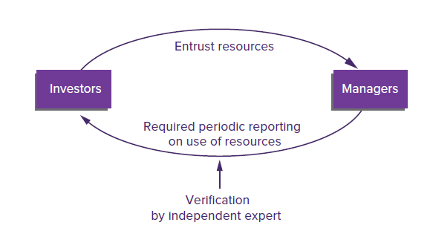
Hypothesis explaining demand for Assurance
Agency theory
stewardship hypothesis
Information hypothesis
aid in decision making
Insurance Hypothesis
insurance against potential losses
Source: Grant, G. & Simnett, R. (2017). Auditing & Assurance Services In Australia (rev: 6th Ed), Sydney, Australia: McGraw Hill

Slide 22
Benefit of Assurance
Characteristics of demand for assurance results in following benefits:
      Increased relevance and reliability of assured information means that shareholders and debtholders will invest with greater confidence, reducing information risk, and therefore a reduced cost of capital.
      Financial analysts will make more accurate and informed recommendations.
      recommendations by the assurance provider to improve the efficiency and effectiveness of operations
      a positive influence on the behaviour of people whose activities are being assured.

Slide 23
LO 1.4
The auditor–client–public relationship and the expectation gap

Slide 24
The Expectation Gap
Defined as: ‘the gap between society’s expectations of auditors and auditors’ performance as perceived by society’.
There are three components of the expectation gap:
  The reasonableness gap between what society expects auditors to achieve and what they can reasonably be expected to accomplish
  The performance gap arising from deficient standards
  The performance gap arising from deficient performance by auditors.

Slide 25
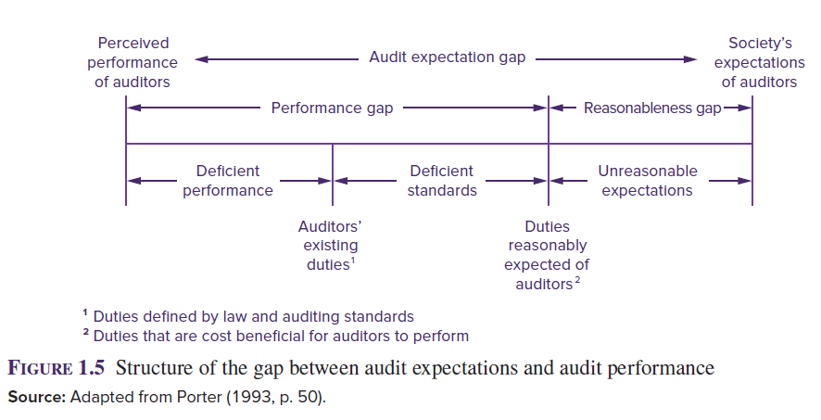
The gap between audit expectation and audit performance
Source: Grant, G. & Simnett, R. (2017). Auditing & Assurance Services In Australia (rev: 6th Ed), Sydney, Australia: McGraw Hill

Slide 26
The Information Gap
Currently there is an ‘information gap’ between what users believe is needed to make informed investment and fiduciary decisions, and what is available to them through the entity’s audited financial report or other publicly available information.
A perception exists that there should be more transparency about:
      the entity and its financial report, particularly key financial reporting risks and how they are being addressed; and
      the audit performed, including key areas of audit risk.
Recent reporting initiatives for improving the auditor’s report will be discussed later in this course.

Slide 27
The Expectation Gap can be reduced by:
  Auditors performing their duties appropriately
  Undertaking peer reviews of work performed
  Reviewing and updating auditing standards.
  Educating the public.
  Enhanced reporting explaining audit processes and levels of opinion auditors provide to the entity.
  Greater attention to the risk of material fraud occurring.

Slide 28
LO 1.5
The role of and authority of Auditing Standards

Slide 29
Auditing Standards
Auditing standards in Australia are developed by the Auditing and Assurance Standards Board (AUASB).
The standards prescribe the basic principles and essential procedures governing the conduct of an auditor.
Guidance Statements (GSs) provide guidance on procedural matters or industry-specific issues, but do not establish new principles or amend existing standards.
For audits conducted under the Corporations Act 2001, the auditing standards (ASAs) must be applied, thus giving them legal authority.

Slide 30
Auditor’s responsibilities under the Corporations Act 2001
Management is responsible for the preparation and presentation of appropriate accounts. Accounts are to be accompanied by a report of an independent auditor appointed by the shareholders.
Section 307A gives legal backing to the auditing standards as it requires auditors to conduct audits and reviews of financial reports in accordance with auditing standards.

Slide 31
Auditor’s responsibilities under the Corporations Act 2001
Management is responsible for the preparation and presentation of appropriate accounts. Accounts are to be accompanied by a report of an independent auditor appointed by the shareholders.
Section 307A gives legal backing to the auditing standards as it requires auditors to conduct audits and reviews of financial reports in accordance with auditing standards.
Auditors are responsible for reporting to company members whether the financial report:
      is in accordance with the law, including compliance with accounting standards (s 296)
      provides a true and fair view (s 297).

Slide 32
LO 1.6
Other applications of the assurance function

Slide 33
Audit of activities other than Financial reports
Compliance engagement- -examination for the purpose of reporting on legality and control of operations.
Performance engagement analyses organisation structure, internal systems, workflow and managerial performance efficiency, effectiveness and economy of these items.
Comprehensive engagement- usually includes components of compliance, performance and financial report audits.
Forensic audit - associated often with fraud detection.
Assurance on subject matter other than historical financial information - including prospective financial information, internal controls, and sustainability and carbon emissions reports.

Slide 34
References
Grant, G. & Simnett, R. (2017). Auditing & Assurance Services In Australia (rev: 6th Ed), Sydney, Australia: McGraw Hill
Moroney, R., Campbell, F., & Hamilton, J., (2017). Auditing: A Practical Approach, (3rd ed), Sydney, Australia: Wiley

